Slide 1

InsuranceSuite 10 Fundamentals
New Features

Slide 2
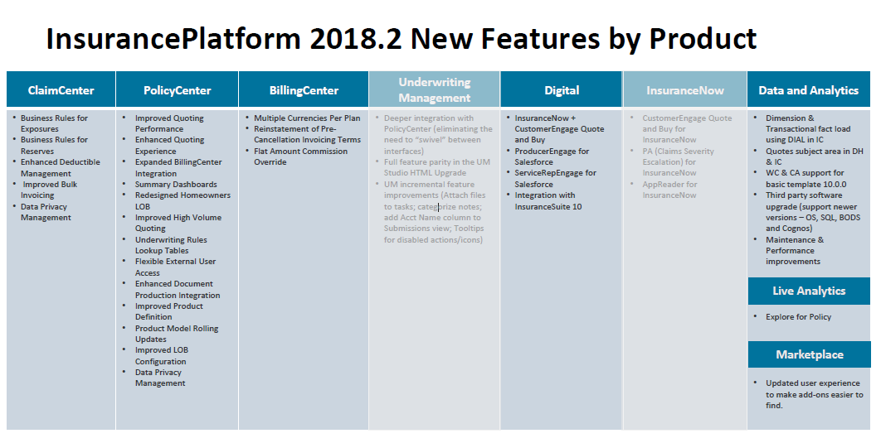

Slide 3
Guidewire V8 , V9 , V10 Key OOTB Features
 | Version 8 | Version 9 | Version 10
ClaimCenter | •Services and Vendor Support •Customer Service Tiers •Weighted Workload Balancing •Multicurrency Reserving •Enhanced Aggregate Limits | •Business Rules framework for Activities •Financial configurability •Straight through Invoice Processing •Vendor Documents/Multiple Document upload •Improved Subrogation Capabilities •Expanded Cloud deployment | •Refreshed UI, theming and user preferences •Business rules framework for Exposures and Reserves •Improved Bulk Invoicing •Enhanced Deductible management •Improved Data privacy management •Restful API framework
PolicyCenter | •Multicurrency Policies •Account holder info screen •Policy Data spreadsheet import/export •Multicurrency integration with BillingCenter | •Underwriting Rules Management •Integrated Spotlight •Rating management enhancements •Policy Contingencies •Loss ratio calculation & Estimated Premium •Integrated Payments | •Refreshed UI, theming and user preferences •Summary Dashboards •Enhanced Quoting Experience - Two step quoting & Asynchronous quoting •Underwriting Rules Lookup tables •Improved Data privacy management •Restful API framework
BillingCenter | •Multicurrency •Broker Bill Reconciliation •Cash and Return Premium plans •Policy-Level Cash •PolicyCenter Integrations using multicurrency | •Charge Invoicing capabilities •Policy Closure and Archiving with Read-Only restore •Producer Payment Batch Improvements •Equity warnings and Hold statements •Expanded Cloud deployment | •Refreshed UI, theming and user preferences •Flat Amount Commission Override •Reinstatement from Pre-cancellation Invoicing Terms •Multiple currencies per plan •Improved Data privacy management •Restful API framework

